Slide 1
Visioning and Design Codes Workshop
Capel Neighbourhood Plan
Mark Hughes & Holly McMahon
AECOM

Slide 2
What is a vision & why is it useful?

Slide 3
Worcestershire Parkway

Slide 4
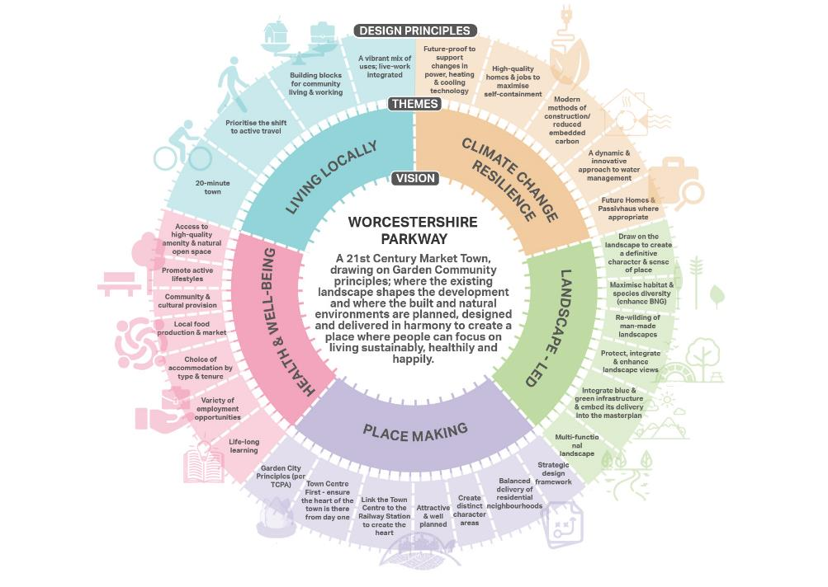
Worcestershire Parkway

Slide 5
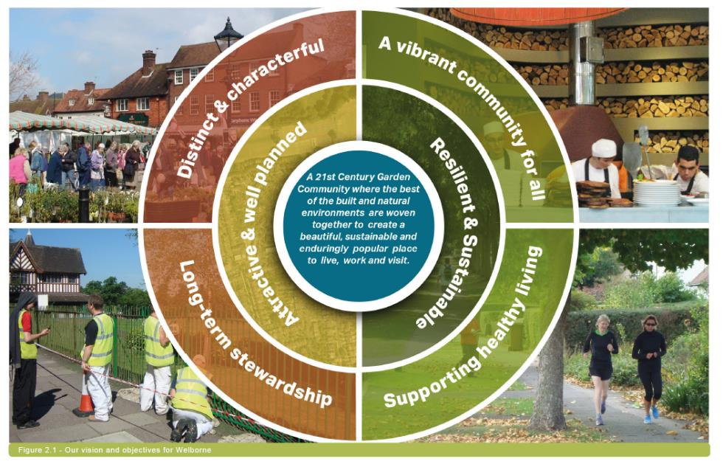
Welbourne

Slide 6
University of Greenwich

Slide 7
Design Guidance and Codes Background: promoting good design in neighbourhood planning

Slide 8
“Good design is a key aspect of sustainable development, creates better places in which to live and work and helps make development acceptable to communities”
National Planning Policy Framework

Slide 9
“Design policies should be developed with local communities, so they reflect local aspirations, and are grounded in an understanding and evaluation of each area’s defining characteristics”
National Planning Policy Framework

Slide 10
“Neighbourhood planning groups can play an important role in identifying the special qualities of each area and explaining how this should be reflected in development”
National Planning Policy Framework

Slide 11
DLUHC/Locality technical support
Almost through a 4-year DLUHC support programme
Includes technical support and grant funding

Slide 12
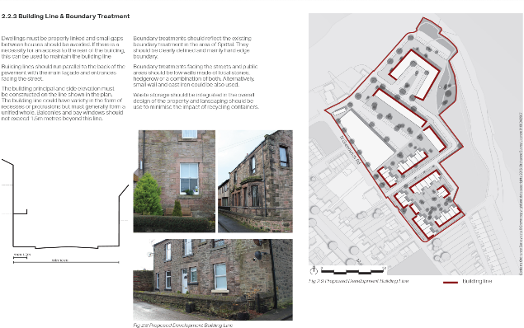
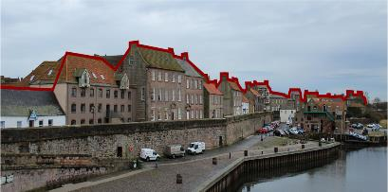
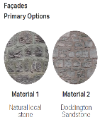
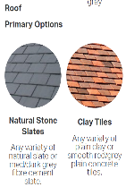
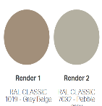
DLUHC/Locality technical support
Over 300 groups supported in design and masterplanning so far

Slide 13
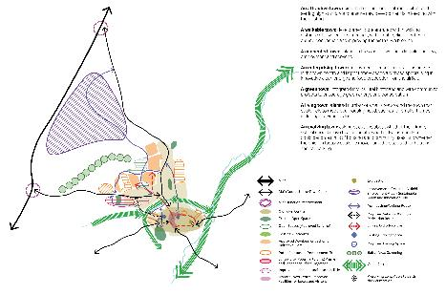
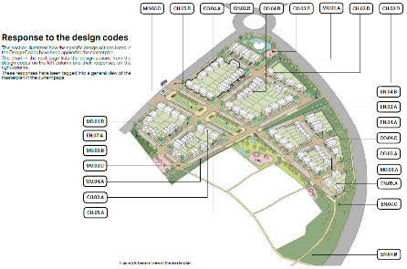
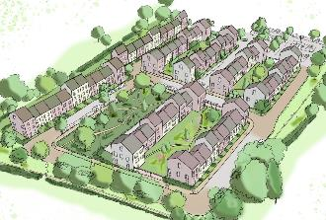
DLUHC/Locality technical support
Over 300 groups supported in design and masterplanning so far

Slide 14
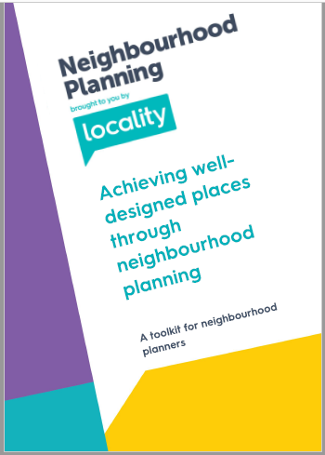
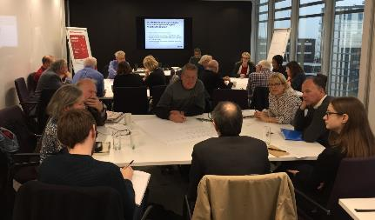
Design toolkit
www.neighbourhoodplanning.org/toolkits-and-guidance/
Produced with input from 15 neighbourhood planners + DLUHC Design Team

Slide 15
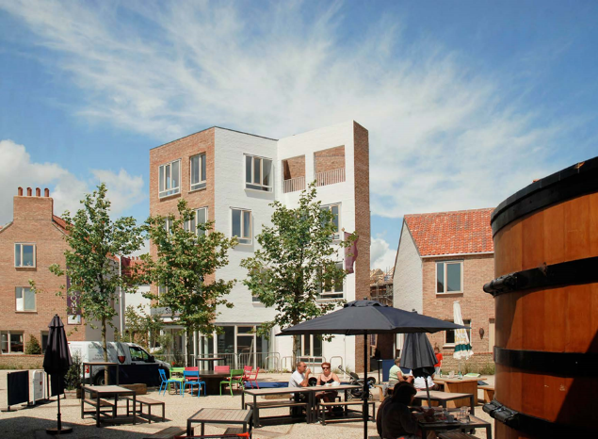
Key message: design in context
Good design means different things in different contexts
Understand what makes a place special
Context includes character, assets and constraints
Tibby’s Triangle in Southwold, Suffolk

Slide 16
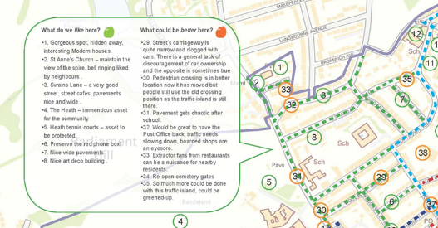
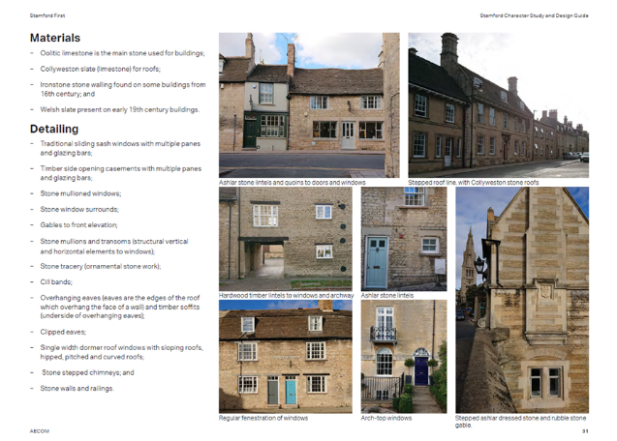
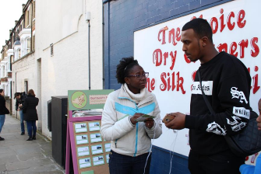
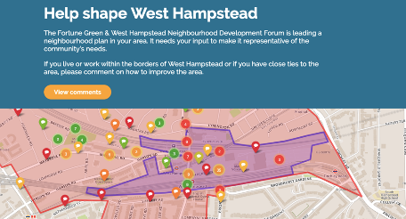
Tools to define the special qualities of an area

Slide 17
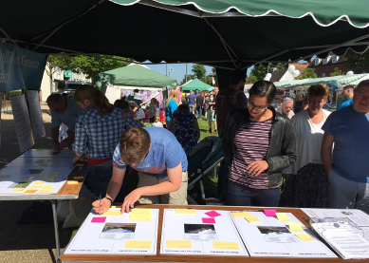
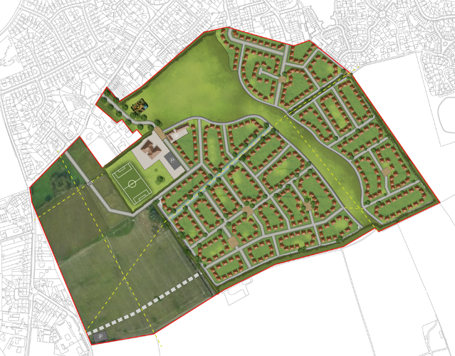
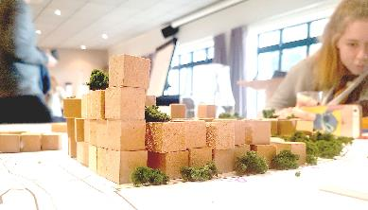
Tools to define how new development should be designed
Masterplan by AECOM for Carlton Colville in Suffolk

Slide 18
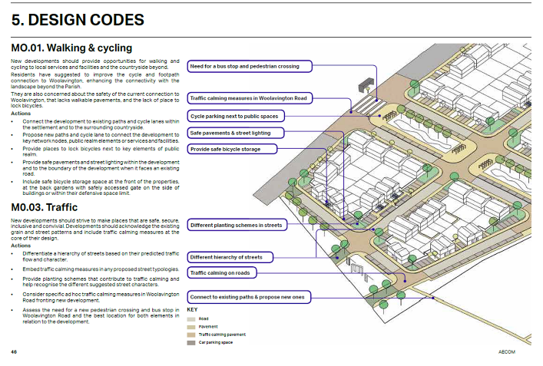
…including design codes
Provide detailed parameters for development of a site or area
Could specify distances between buildings, lengths of gardens, heights, materials, car parking
Usually need to build on a masterplan if site specific
Notes:
*specifically reference Paddock Wood/include it in the presentation
*include the meeting & some context on the Paddock Wood – shared context and willingness to work together and share ideas & experiences

Slide 19
Area design code examples

Slide 20
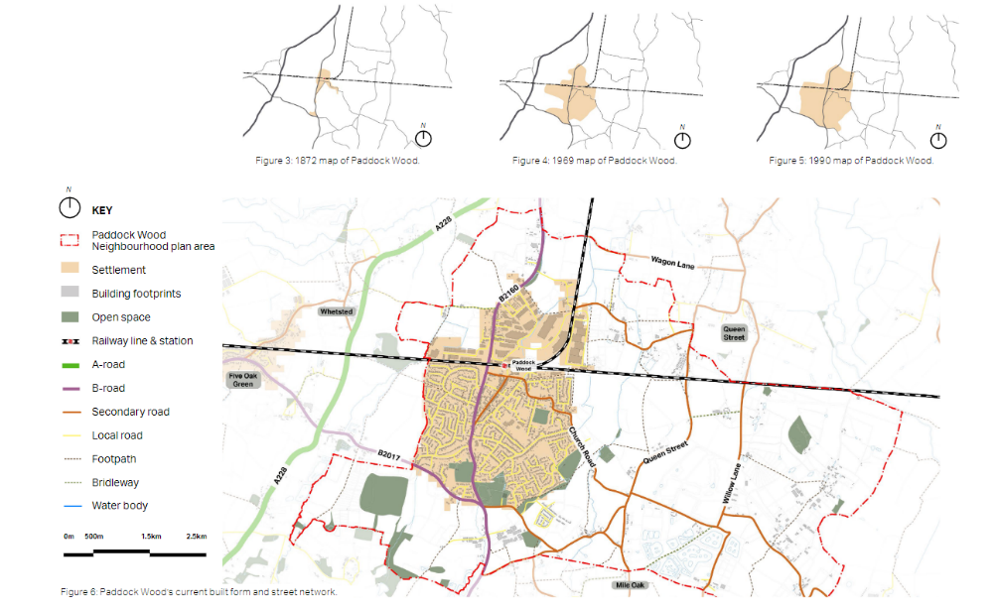
Paddock Wood

Slide 21
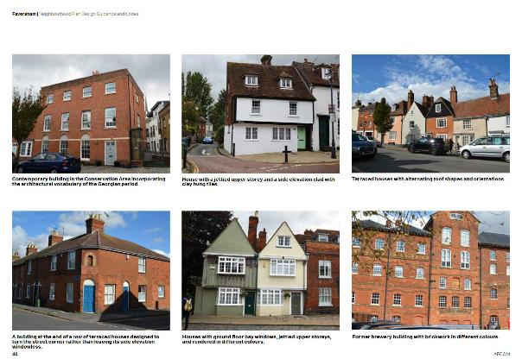
Faversham, Kent – 5000 homes planned in historic town
Design guidance and codes for:
Strategic principles & best design practice
Built form
Streets and parking
Environment & energy efficiency

Slide 22
Engagement

Slide 23
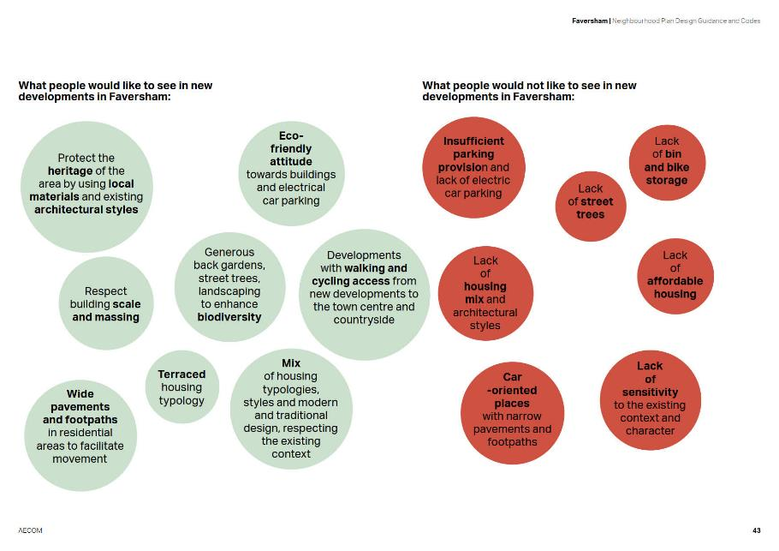
Engagement

Slide 24
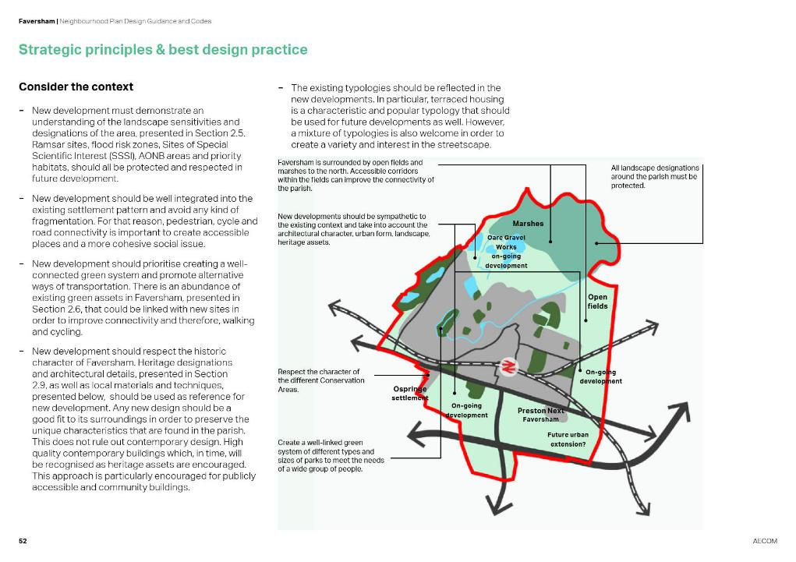
Notes:
*pick out just the strengths from the examples of each design code examples
*keep the extra slides just hide it

Slide 25
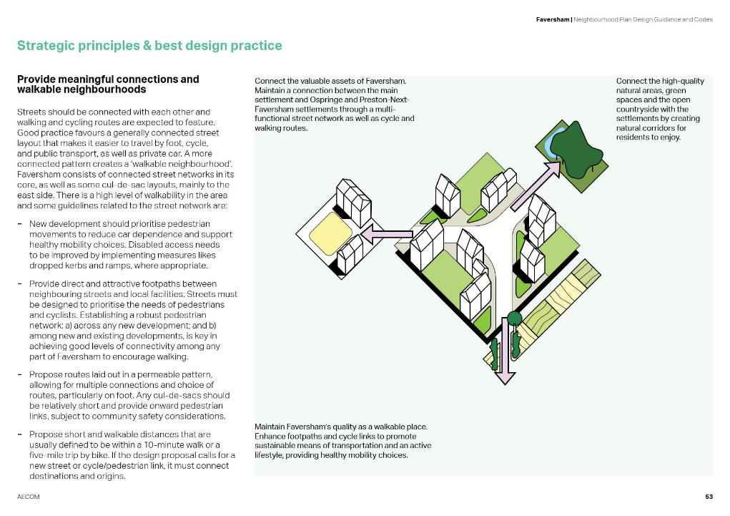

Slide 26
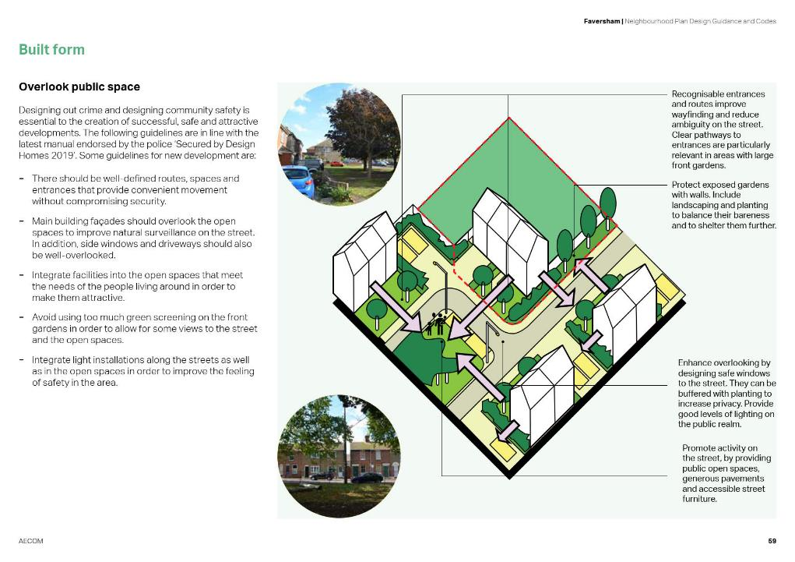

Slide 27
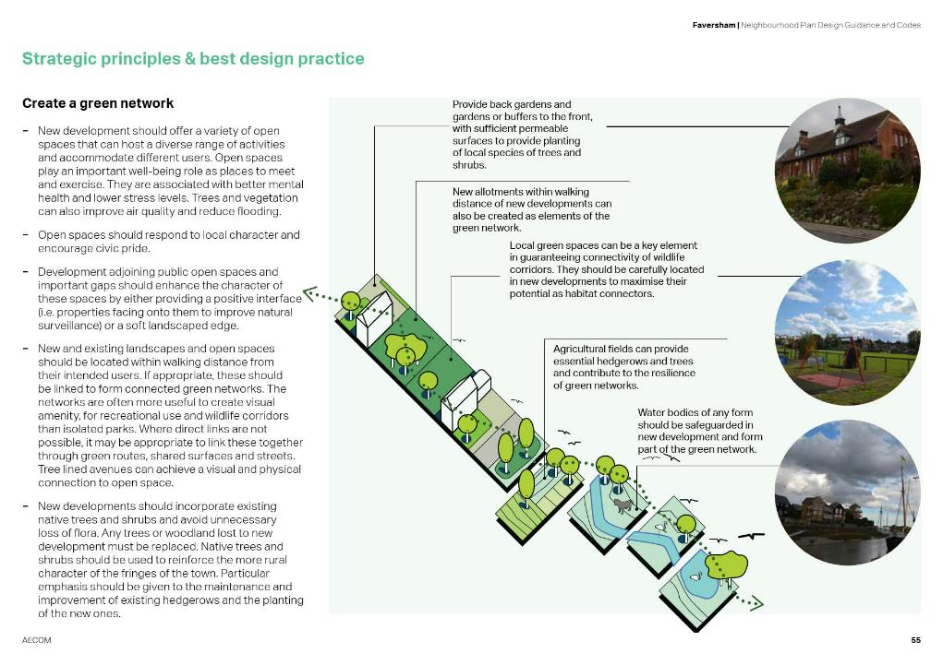

Slide 28
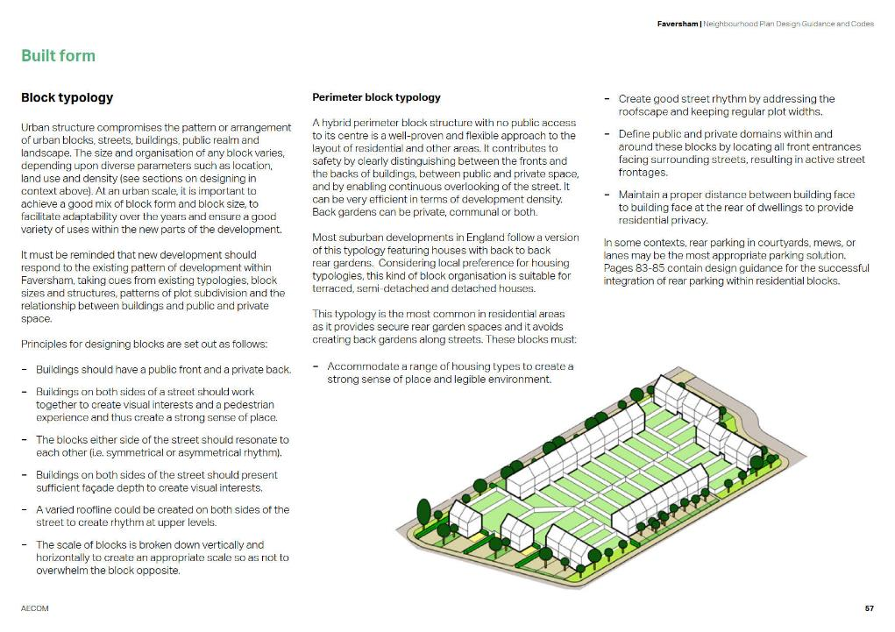

Slide 29
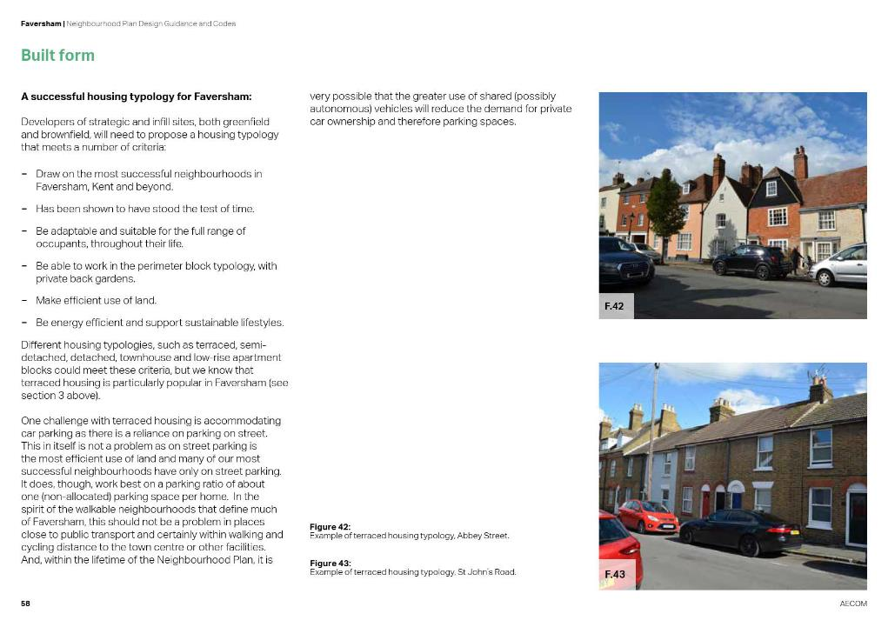

Slide 30
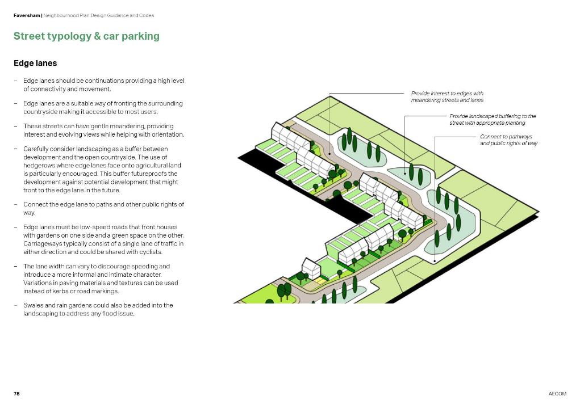

Slide 32
Peacehaven & Telescombe, East Sussex – character, infill & growth
INCEPTION &
SITE VISIT
CO-DESIGN PROCESS
ANALYSIS
MASTERPLAN
WORKSHOP 1
DESIGN CODE DEVELOPMENT
WORKSHOP 2
FINAL FEEDBACK
DESIGN CODE

Slide 33
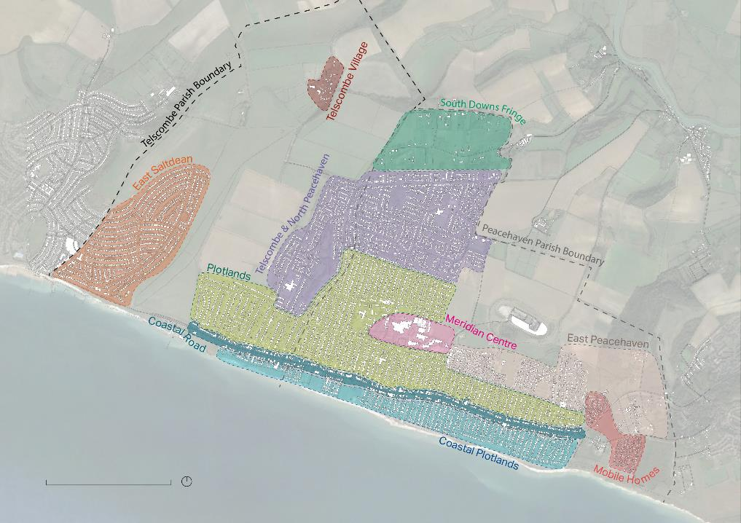
PEACEHAVEN & TELSCOMBE | Design Code
AECOM 19
0
1km N

Slide 34
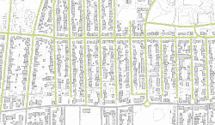
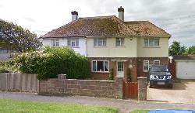
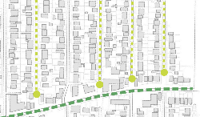
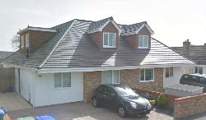
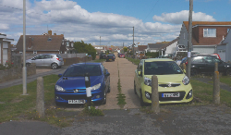
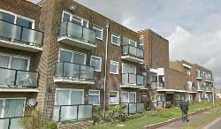
3.01 PLOTLANDS
PEACEHAVEN & TELSCOMBE | Design Code
INTRODUCTION
The plotlands form a key part of Peacehaven and Telscombe’s history with large self-build plots. This history can be seen throughout the plotlands character area within the morphology, which lends itself to a grid structure orientated parallel and to the coastline. Although there is a grid layout, many of the perimeter blocks do not provide a high level of connectivity for vehicles, as Figures 17 and 18 show how many of the roads end while pedestrian access continues.
Figure 22 shows how the streets have an open character due to the building height and street width ratio. Figure 24 shows that the green verges can be up to 2.5m wide, which is generally wider than elsewhere in the area.
Historically, bungalows have dominated the plotlands, however over time large plots have been subdivided to create more, but smaller bungalows, as well as more 2-storey housing which is mainly semi-detached or terrace housing.
Many of the buildings within this character area have pitched or hipped roofs, however gable ended pitched roofs are also
LAYOUT
HEIGHT
Figure 16. Historical self-build plots were arranged in a grid structure which is still present today.
Figure 19. 2-storey semi-detached house.
Figure 17. Plan showing roads that are closed at the end.
Figure 20. Example of bungalow with converted roof.
KEY CHARACTERISTICS
The grid layout and open character of the streets
differentiate this area from others in the town.
The subdivided plots are a key characteristic as they dictate the type of housing that might go on a plot.
There is a growing number of 2-storey houses and converted bungalows which are interspersed with older bungalows, creating a unique mixture of typologies, heights and massing.
The materials used throughout the character area are highly varied.
Figure 18. Example of road end with car parking.
Figure 21. Example of 3 storey flats within the
Plotlands.
20
AECOM

Slide 35
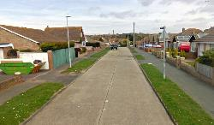
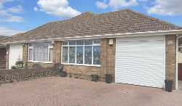
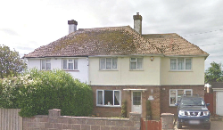
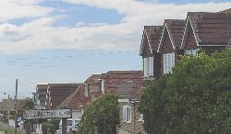
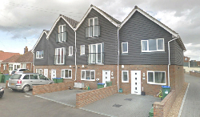
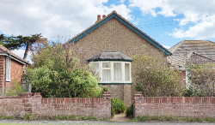
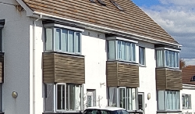
PEACEHAVEN & TELSCOMBE | Design Code
STREET
PLOT
BUILDING
Figure 22. Typical plotland street.
Figure 25. Large plot split in two with semi- detached bungalows.
Figure 28. Hipped roof with chimney.
Figure 23. Roof line along a street within the plot- lands.
Figure 26. Plot subdivided to create 4 terrace houses.
Figure 29. Original style bungalow with gable ended pitched roof.
3-6m 1.5m 2.5m
Private drive Footpath Green way verge
5m
2.5m 1.5m 3-6m
Green Footpath Private drive verge way
Carriageway
SUBDIVIDED PLOT SINGLE PLOT
Figure 27. Diagram showing the subdivision of large plots.
Figure 24. Typical section from the plotlands.
Figure 30. Example of poorly chosen materials that are easily weathered by the salt air.
AECOM
21

Slide 36
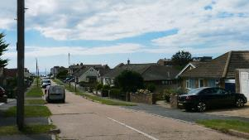
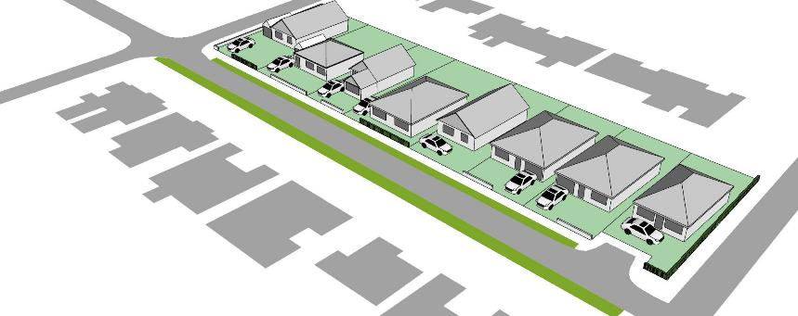
4.0 DESIGN CODES
PEACEHAVEN & TELSCOMBE | Design Code
4.1. COASTAL PLOTLANDS AND PLOTLANDS
Existing Characteristics:
Proposed Character:
Streets laid out in a grid structure, with views to the sea.
Large plots that have been sub-divided.
Large green verges.
Filtered views between the dwellings.
Predominantly detached or semi-detached single-storey bungalows.
Mixture of roof types including pitched and hipped roofs.
On-plot car parking either in front of the house or to the side. Some dwellings also have a garage.
Retain the history of the plotlands which provides a unique character to this area through the layout.
A greater connection to nature by retaining views to the sea as well as enhancing the streets with more greenery.
Buildings that respond to the existing bungalows but offer a more contemporary approach for the height, form and massing. The materials and finishes of the buildings should also be to a high standard.
Figure 166. Existing Plotlands character.
Figure 167. Typical existing street within the Coastal Plotlands and Plotlands character area.
42
AECOM

Slide 37
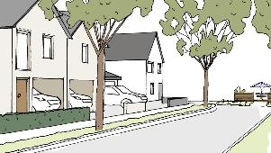
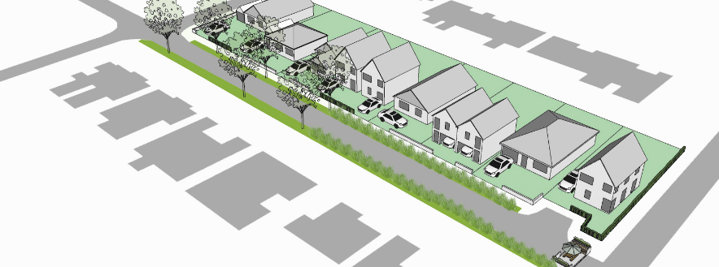
PEACEHAVEN & TELSCOMBE | Design Code
COASTAL PLOTLAND AND PLOTLAND STREET CODES
PS1.
Retain permeable grid layout.
PS2.
Retain existing
PS3.
Introduce landscaping along the green verges (see p.44 for detail on types of landscaping).
PS4.
Retain linearity of the streets and views towards the sea.
green verges.
*Note: All necessary surveys and safeguards must be taken when proposals come forward for the Coastal Plotlands to account for erosion of the chalk cliff.
PS5.
In instances where the street is closed, a pocket park can be introduced (see p.45).
Figure 168. Sketch showing proposed Plotlands character.
Figure 169. Proposed street transformation of Coastal Plotlands and Plotlands character area.
AECOM
43

Slide 38
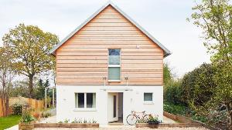
PEACEHAVEN & TELSCOMBE | Design Code
COASTAL PLOTLAND AND PLOTLAND BUILDING CODES
PB1.
Building Line Buildings should be setback between 3-6m
from the edge of the plot.
PB2.
Roof Types
The acceptable roof types include gable, hip, M-shaped, saltbox, Jerkinhead (Dutch gable), Clerestory. Pitched roof dormers are acceptable, however square dormers should be avoided.
PB3.
Corners
Corner buildings should address at least two principal façades; if there is any other publicly visible facade, this will also be treated as a principle facade in terms of quality and appearance.
PB4.
Grouping
No more than two units should be attached to retain filter views between houses.
PB5.
Heights
The maximum height for buildings is 2-2.5 storeys (indicative 6-7.5m at eaves).
Figure 170. Contemporary dwelling with flexible ground floor for
adaptable living.
PB6.
Boundary Treatment
A low wall (max height 1.2m) using brick, flint or render, vegetation, ironmongery or a mix of these. Wood panel fencing should be avoided.
PB7.
Car Parking
On-plot parking should be within curtilage. The parking space can be to the side
or in front of the building, however a maximum of one space should be in front and should be accompanied by landscaping.
PB8.
Frontage Treatment
Principal windows and access doors should be located at the front of the building.
Figure 171. Proposed building transformation of Coastal Plotlands and Plotlands character area.
44
AECOM

Slide 39
PEACEHAVEN & TELSCOMBE | Design Code
COASTAL PLOTLAND AND PLOTLAND SECTIONS
Figure 172. Section showing a typical existing street within the Coastal Plotlands and Plotland character areas.
PS3.
PB8.
PB6.
PB5.
PB4.
PB2.
PB7.
6-7.5m
1.2m
Filtered Views
Figure 173. Section showing proposed transformation for the Coastal Plotlands and Plotland character areas.
AECOM
45

Slide 40
Area based design codes – some lessons
Area codes should not be too prescriptive – leave space for good designers to design to context
Guidance or codes? The best ones have elements of both
Coding works better for streets, building lines, heights, materials
Guidance is better for local character and the basics of good design
Local design codes show applicants that the community is serious about design quality

Slide 41
Character areas
Examples of design codes for character areas

Slide 42
Birchington

Slide 43
Birchington

Slide 44
Birchington

Slide 45
Birchington

Slide 46
Birchington

Slide 47
Abbots Langley

Slide 48
Abbots Langley

Slide 49
Wherstead

Slide 50
Wherstead

Slide 51
Wherstead

Slide 52
Wherstead

Slide 53
Wherstead

Slide 54
Wherstead

Slide 55
Visioning and Design Codes Workshop
Capel Neighbourhood Plan
Mark Hughes & Holly McMahon
AECOM
Notes:
* Half an hour for each of the sessions; collect a folder of the full document.

