Slide 1
Community and Recreational Facilities
The Purpose of the Neighbourhood Plan is to:
Improve the community and recreational facilities in our parish
2. Ensure Five Oak Green does not become a backwater should the TW Local Plan be approved

Slide 2
Capel is a large rural area with limited community facilities for people to meet
Village Halls ageing no improvement since 2006 Plan
Some closed e.g. Scout Hut
Church facilities either in need of work or small

Slide 3
Recreational facilities and allotments managed by the Parish Council….
Some improvement in recent years MUGA; new play area (funded by Friends of FOG Rec and CPC)
Funding for allotment improvements by CGPS
Thriving cricket club football pitches let out to two teams

Slide 4
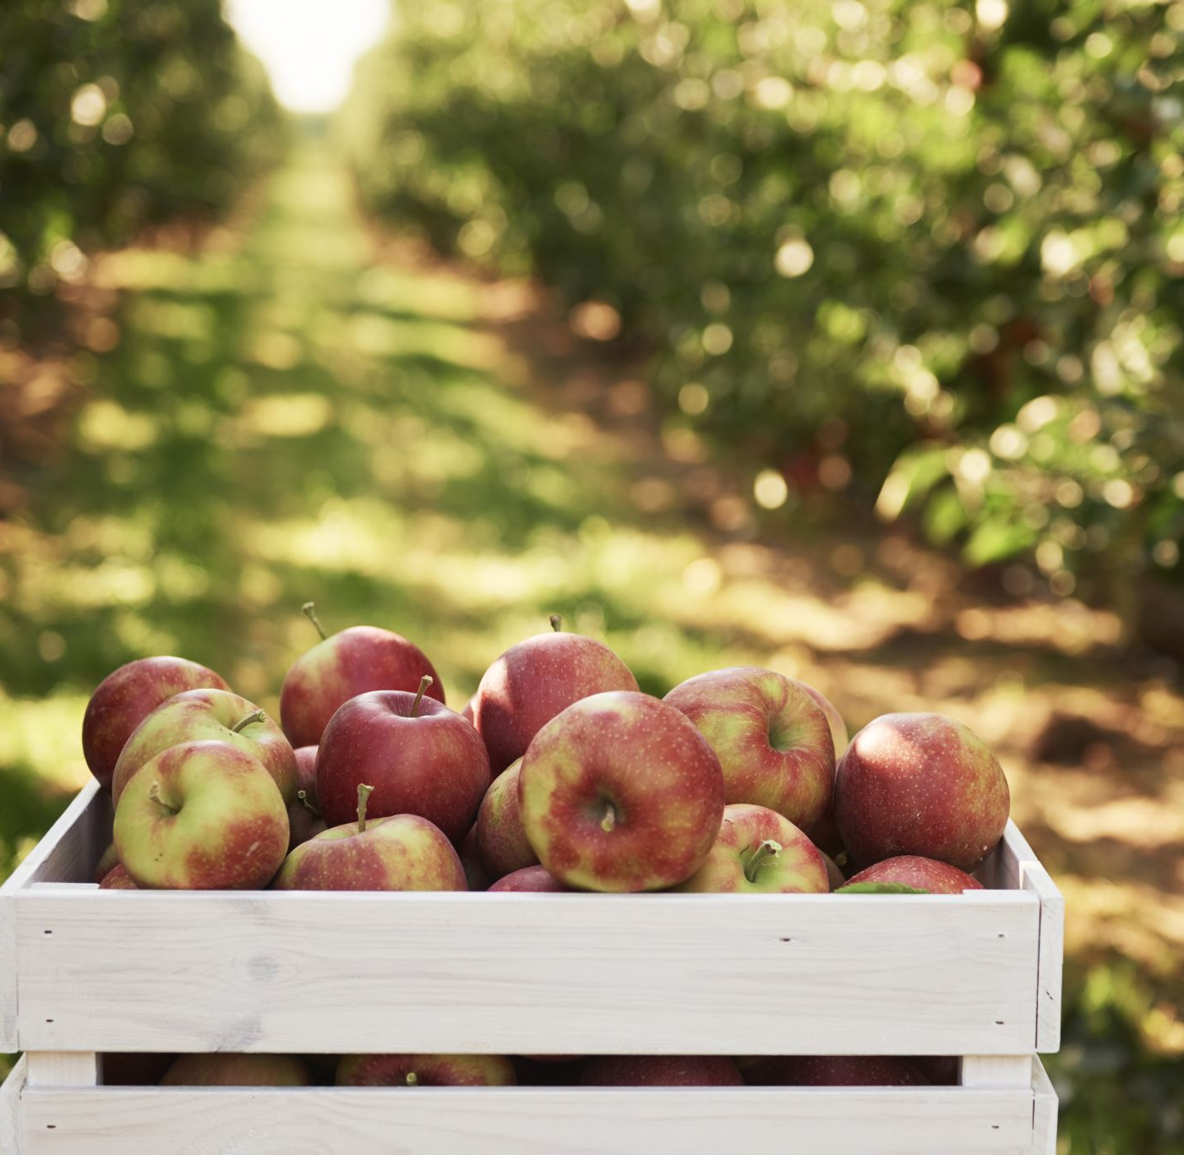
Community Orchard since 2012…
Improvements to signage and new seating and information boards planned…

Slide 5
Vision for Capel questionnaire suggested people want better community facilities
Very little on Capel Parish (outside the Strategic Sites) on this in the emerging TW Local Plan – neighbourhood Plan needs to remedy this or Five Oak Green and the hamlets around will become a backwater whether or not the housing

Slide 6
Local pubs
There are some excellent pubs in the parish but none of them are within easy walking distance of Five Oak Green – since the 2006 Plan one pub has been demolished and one closed – do we wish to designate this as an asset of community value?

Slide 7
Health and Dental Care
There are no health or dental facilities in the parish – should the Neighbourhood Plan include a demand for S106 funding to make access easier to these for new and existing residents?

Slide 8
Local Needs Housing – the AECOM Housing Needs Assessment laid down a need for 105 affordable homes for local needs in the parish
If the emerging TW Local Plan is adopted in full or in part we would expect these to be accommodated in the new development – if not we would look at small scale schemes around the edge of Five Oak Green to accommodate the need.

Slide 9
How can we achieve improved facilities in the coming years?
Ensure what the community wants is in the Neighbourhood Plan which is a Supplementary Planning Document that developers and TWBC have to take note of.
The work of community groups, charities and sports teams (e.g. Capel CC; FOG in Bloom; Friends of FOG Rec) can support this.

