Slide 1
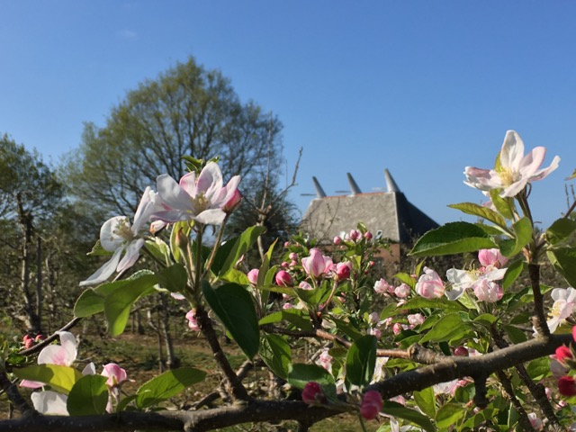
Heritage

Slide 2
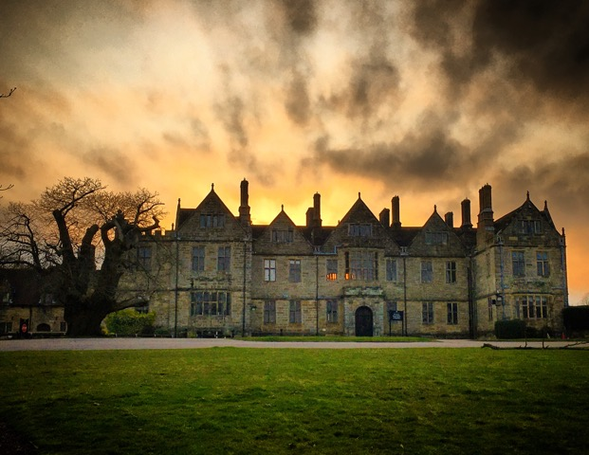
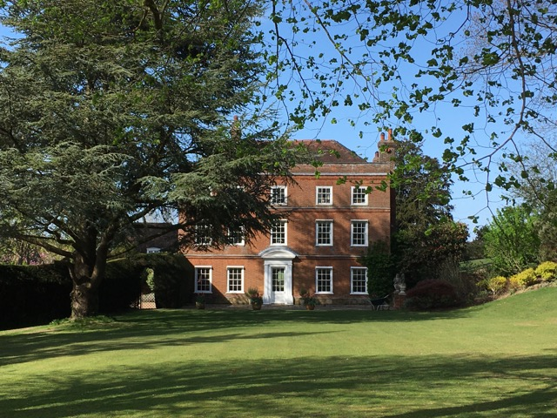
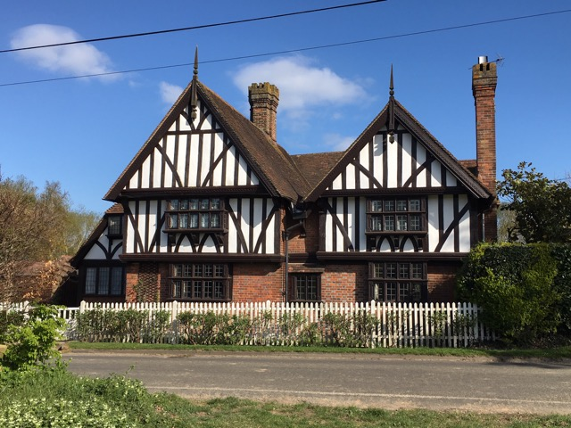
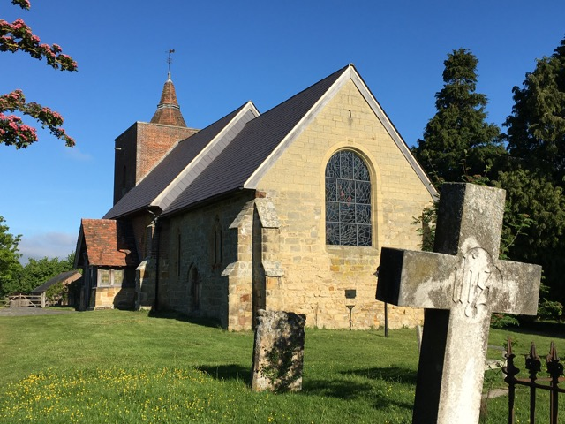
Designated Heritage Assets
Historic England entries for Capel are in excess of 140
These include:
Grade 1 All Saints Church at Tudeley with its 12 stained glass windows by Chagall
Grade 1 St Thomas a Becket at Capel with its mediaeval frescos
Somerhill Grade 1 house and historic park and garden
Four Grade 11* Upper Postern Farmhouse, Thistles/Wenhams, Tatlingbury Farmhouse and the Postern
Castle Hill Scheduled Monument
Also noteworthy is the 13C Grade 11 Badsell Manor Farmhouse

Slide 3
Non- designated heritage assets
Many of the historic features of the landscape are of great importance to the local community.
There are many oast houses that do not enjoy the protection of statutory listing but are none the less highly valued. They are also finite asset for the future.
Generally a heritage asset will demonstrate significant architectural, artistic and/or historic interest.
LHAs do not have to be buildings, this is particularly true of Capel where the natural landscape in the main provides a valued rural setting for the many remaining dispersed farmsteads reinforced by the protection of high functioning MGB that separates Tonbridge and Paddock Wood.
A good example would be Reeds Farm, the last remaining hop farm in Capel which is of great local value and significance.
KCC do maintain an Asset Register which includes historic farmsteads and recognises the4 clusters of dispersed farmsteads which often have unlisted lasts and barns in the grouping.

Slide 4
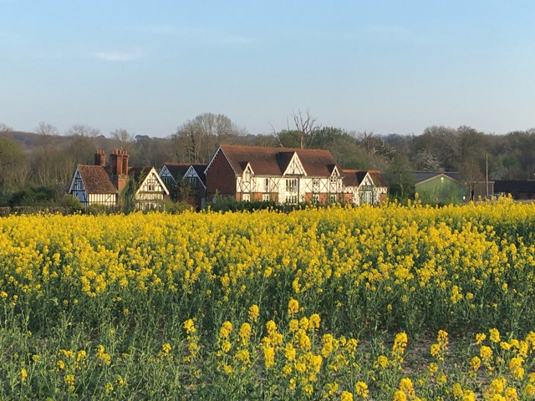
The research has re-emphasised the importance of historic farmsteads to Tunbridge Wells' rural areas.
Traditional farmstead groups and their buildings make a positive contribution to local character and distinctiveness. “…..they are under the greatest threat of neglect on one hand, and development on the other, than any rural building type”. National and local research has highlighted the significance of traditional farmsteads as assets which contribute to landscape character, local distinctiveness and rural economies and communities.⁴ Kent Farmsteads Assessment Guidance 2016
The low weald characteristics, the rural nature of Capel and the importance of the GB setting of the majority of these assets are of considerable significance.
The lack of urban sprawl contributes greatly to the settings.

Slide 5
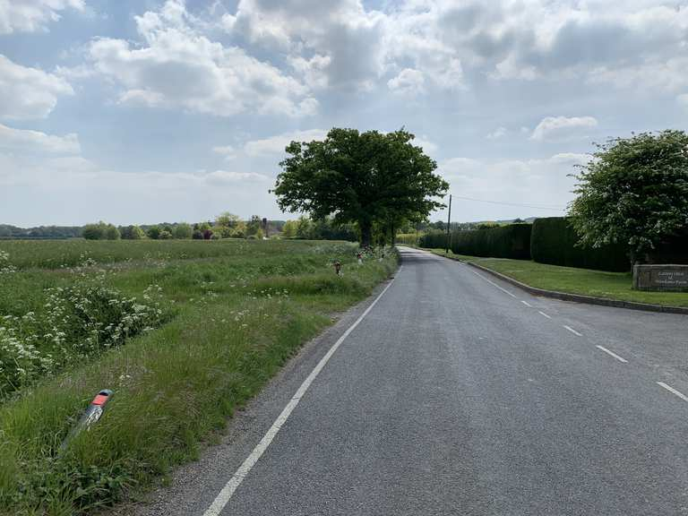
Rural Lanes
Five roads within Capel are included in the “Rural Lanes” Tunbridge Wells Supplementary Document.
Sherenden Road (No 125)
Hartlake Road (no 124)
(Both are amongst the most highly scoring lanes in the borough. Hartlake Road is in the top 5% for historic value (Appendix 4) whilst both Sherenden and Hartlake are in the top 10% for high landscape and amenity value (Appendix 3) ⁵ SPD “Rural Lanes”)
Sychem Lane (no. 127)
Church Lane (No 128)
Alders Road (no 126)

Slide 6
Policy and Design Codes
Policy C2: Reflecting the character of Capel’s settlements through high quality design
Policy C3: Meeting the highest environmental standards
Policy C5: Conserving Heritage Assets
Policy C6: Rural landscape including rural lanes

